Slide 1
Every connection, considered.
A clear caller path, from draft to route.
IVR Cloud

Slide 2
Make the caller’s next step clear
Introduce the organization.
Offer understandable choices.
Name each outcome explicitly.
Notes:
This is an IVR Cloud design specimen. All example organizations and version numbers are fictional. It is not a customer story or production configuration.

Slide 3
From draft to phone route

Slide 4
Publication and deployment have different effects
Publication
Creates an immutable version.
Preserves version history.
Deployment
Names a phone route.
Activates a published version.
Notes:
Publishing alone does not establish that callers use the new version. The current application exposes deployment separately.

Slide 5
Keep the version context visible
State | Version | Meaning
Draft | v4 | Editable
Published | v3 | Immutable
Active route | v2 | Used by callers
Notes:
Version numbers are fictional. A route can remain on an older version after a newer publication exists.

Slide 6
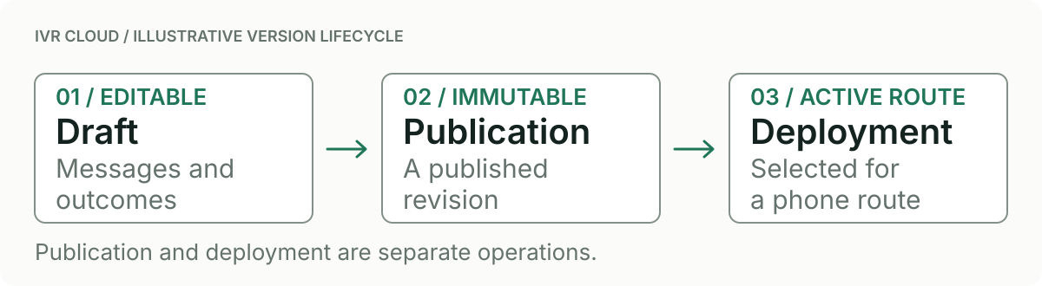
Keep the three operations distinct
Illustrative IVR version lifecycle.
Notes:
This diagram illustrates separate operations, not actual production state. Names and records in the sample are fictional.

Slide 7
Show the complete caller path
Name the root step.
Label menu and transfer outcomes.
Explain unconnected steps.

Slide 8
Make each route change explicit
Name the number and endpoint.
Select a published version.
Verify activation state.
Notes:
Rollback requires an earlier ready deployment. Do not infer readiness from an older publication alone.

Slide 9
Complete the path before proposing activation
Review missing outcomes, then identify the intended phone route and published version.
Notes:
This slide states the example’s next decision; it does not authorize any live change.

